Slide 1
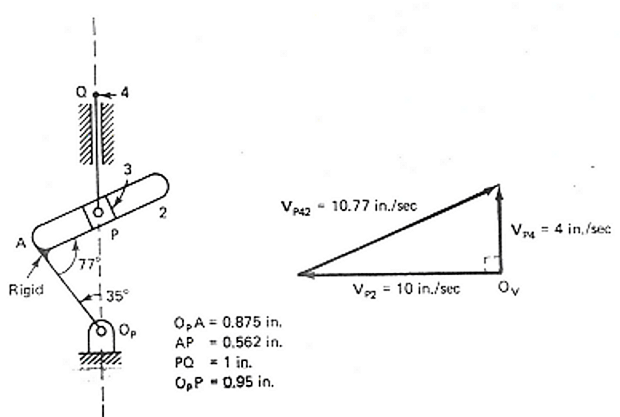
Velocity and acceleration analysis analysis using vectors
Problem 2
Determine the linear acceleration of A_{P4} if α₂=0

Slide 2
Solution 2 : Acceleration analysis for P
ω₂
Sense of rotation is found from direction of V_{P2}
Analyze available information
V_{P2} = 10.0 in/sec. O_{P}P=0.95.
  Hence ω₂= V_{P2}/O_{P}P= 10.53 rad/sec.
    Hence a^{n}_{P2} = ω²₂ O_{P}P=105.34 in/sec²
α₂ = 0.
  Hence a^{t}_{P2} = 0
V_{P4P2} = 10.77 in/sec.
  Hence a^{c}_{P4P2} = ω₂V_{P4P2} = 10.53 *10.77=113.38 in/sec².
Vector equation
a_{Q4}=a_{P4}=a_{P3}= a_{P4P2}+a_{P2}=a^{s}_{P4P2}+ a^{c}_{P4P2}+a^{n}_{P2}+a^{t}_{P2}

Slide 3

Solution 2 : Acceleration analysis for P
a^{s}_{P4P2}
D, M=?
a_{P4}
D, M=?
a^{s}_{P4P2}= 55
a_{P4} =18
a_{P2}=a^{n}_{P2}
(Since a^{t}_{P2}=0)
= ω²₂ O_{P}P
=105.34
D, M
a^{c}_{P4P2}
=2ω₂V_{P4P2}
= 113.38 in/s²
a_{P4}
Direction – Along OP (O_{p}PO)
a^{c}_{P4P2}
=2ω₂V_{P4P2}
= 113.38 in/s²
a^{s}_{P4P2}
Direction -Along AP
a^{t}_{P2}= 0
a^{n}_{P2} = ω²₂ O_{P}P=105.34
Radially inwards along O_{p}P (O_{p}PO)

